Slide 1
Process Attribute
Course Instructor
Anam Akbar

Slide 2
Process Attributes
The OS stores information about a process in a Process Control Block.(PCB)
The PCB contains the information the operating system needs to know about a process:
Process state and scheduling information
Memory management information
Hardware run state information
Process signaling information
Access control information
I/O and allocated resource Information

Slide 3
Process Attributes
Run State And Scheduling
The OS must know and identify all the process in a particular state
This is usually involves maintaining separate list or queues for each state.
The PCB may contain a link to the appropriate state queues.
For process that are in blocked state the information on the blocking event must be maintained.
Information used by scheduling algorithms, such as priority level or time of last allocation to the CPU can be found in the PCB.

Slide 4
Process Attributes
Memory Management
Each time a process given a control of the CPU, the memory management hardware must be configured so only the memory location allocated to that process may be accessed.
For each process, the OS must maintain a copy of the memory management configuration for that process.
When a process obtains the CPU, a register is set to point to the process’s configuration settings, or the configuration values are copied into special memory management registers.

Slide 5
Process Attributes
Hardware State
On a multi-programmed machine, when a process is given control of the CPU, Various hardware registers must be restored to the values they had when the process was suspended.
The operating system must stores these values for each process that is not in the run state.
Depending on the underlying hardware architecture, this may include values for the
program counter
Accumulator registers
General registers
Stack pointers
Index registers
Arithmetic logic unit condition codes and
Execution priority level

Slide 6
Process Attributes
Resetting all the values when a new process takes control of the CPU is called a context-switch.

Slide 7
Process Attribute
SIGNALING
Signal is a virtual interrupt created by the operating system.
A signal may originate with a process or with the operating systems and is sent to one or more processes.
A process receiving a signal may respond by ignoring it, by terminating, or by executing a specified a function.
There may be a provision for scheduling a signal to be sent at some time in the future.

Slide 8
Process Attribute
SIGNALING
Software timers are signals that a process sends to itself at some point in the future.
The operating system must maintain information on how a process will respond should it receive signals.
It also may need to maintain a list of signals that have been sent to a process but have not yet been serviced.

Slide 9
Access Control
Two types of access control information may be stored:
Information that determines the access rights of the process and
Information on the default access rights assigned to any object created by this process.
Depending on the access control mechanism used, this information may be passwords, capabilities, or access control lists.

Slide 10
Input and Output
The operating system must maintain information on files and devices allocated to a process or opened for I/O by a process.
On most systems, a file or device must be opened before it can be accessed.
An open file table stores information in each file or device opened by a process.
Other information might include the current working directory of a process or a per-process root directory.

Slide 11
OTHER
Process id
Parent Process id
Child Process id
Process group id(s)
User id
Effective User id
Group id(s)
Effective group id(s)
Account id
Priority level

Slide 12
OTHER
Elapsed CPU time
Start time
Scheduled Start time
Maximum CPU time
Memory allocation
Command
Terminal
Termination status

Slide 13
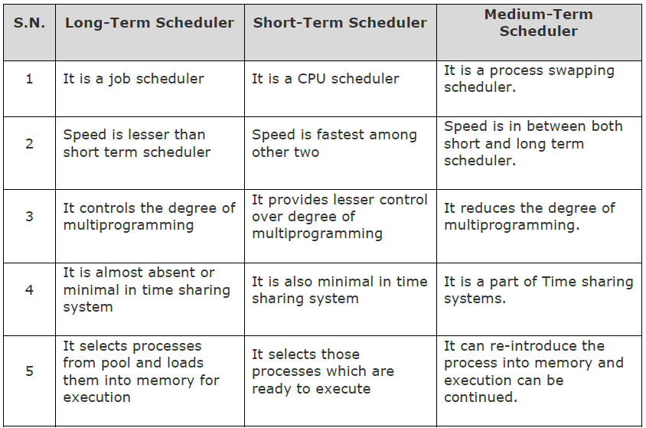
Fresher's

